Slide 1

Board of Directors Meeting
Some thoughts on Product Development
February 2014
Scott Marland, PhD
BioInnovations Gateway Executive Director

Slide 2


Considerations
Is this a product or service that some one is willing to pay for? (NISI)
Is there Intellectual Property that can protect it? (see IP atty)
How will I sell it?
  To who?
  Channel (how)?
  What it the purchasing process?
  Is it reimbursable (patient insurance)?
Margin/Scaling?
Regulatory Pathway?
Exit strategy?
Funding?

Slide 3
Product Development
Idea/concept
The initial identification of a customer pain,
a need or a solution.
M1: Proof of Concept
“Bench top” experimentation and testing to show technical feasibility. Some integrated systems or shapings of a product.
M2: Prototype
A basic, rough yet discrete item beginning to look like a product. Rough parts from non-production type materials
M3: Beta
Near final form factor using parts mimicking production methods.
M4: Production Release
/Pilot Build
Early stage production parts fully verified. Pilot build parts may be sold.
M5: Production/
Sustaining
Complete product using all “volume” methods and parts
M6: End of Life
Manufacturing and support is discontinued

Slide 4
In General…
Understand the problem (pain) you’re solving
Watch and Listen to others (don’t over rely on your own opinion)
Understand your business
Fail Fast (understand the design space)
Develop user/customer relationships ASAP
Constantly seek “user” feedback – make sure you’re “nailing it”
Plan regulatory pathway and prepare from the start
Understand you IP options (see a patent attorney)
Develop good requirements documents
Iterative process (lots of looping back)
Plan for longer times, more expenses and more problems

Slide 5
Adjourn
?

Slide 6
Developing a Commercially Viable Product
S. George Simon
Chief Business Officer
MesaGen, LLC
Translational Medicine Symposium
University of Utah
February 11, 2014
Notes:
Therapeutic focus – although applicable to other areas, reagent, research services

Slide 7
Commercially Viable Product
Sound Scientific, Engineering and Clinical Basis
Understanding the “State of the Art”
  Current Practice of Medicine
  “First in Class” or “Best in Class”
Regulatory Feasibility
  Is there a clearly defined path to FDA approval
Reimbursement
  Outcomes Research aka Healthcare Economics
  aka “the value proposition”
Intellectual Property
  Patents, Trade Secret, Know-how
  Freedom to Operate
Notes:
Access to a good competitive intelligence database

Slide 8
Target Product Profile
A target product profile (TPP) is a key strategic document that summarizes the value proposition of the intended commercial product and assists in the development of a regulatory strategy.
A well-designed TPP provides a structure to ensure that a company embarks on a product development program that is efficient and defines all relevant medical, technical and scientific information required to reach the desired commercial outcome.

Slide 9
Commercialization Plan
Define your Target Product Profile
Generate data that people care about
  Validated, Industry-accepted
  Reflective of the human clinical condition
Regulatory Strategy
  The FDA is your friend
Sales and Marketing Requirements
  Specialty Sales Force or Strategic Partner
Realistic Financial Plan
  Corporate & Business Development strategy must complement the product development strategy
  Understand the value inflection points
Exit Strategy

Slide 10
Reimbursement or Payment
Nic Anderson
N C Anderson Consulting
Notes:
Insurers need to do HTA in order to determine how much they can tax their members. We can’t print money or borrow it from China.

Slide 11
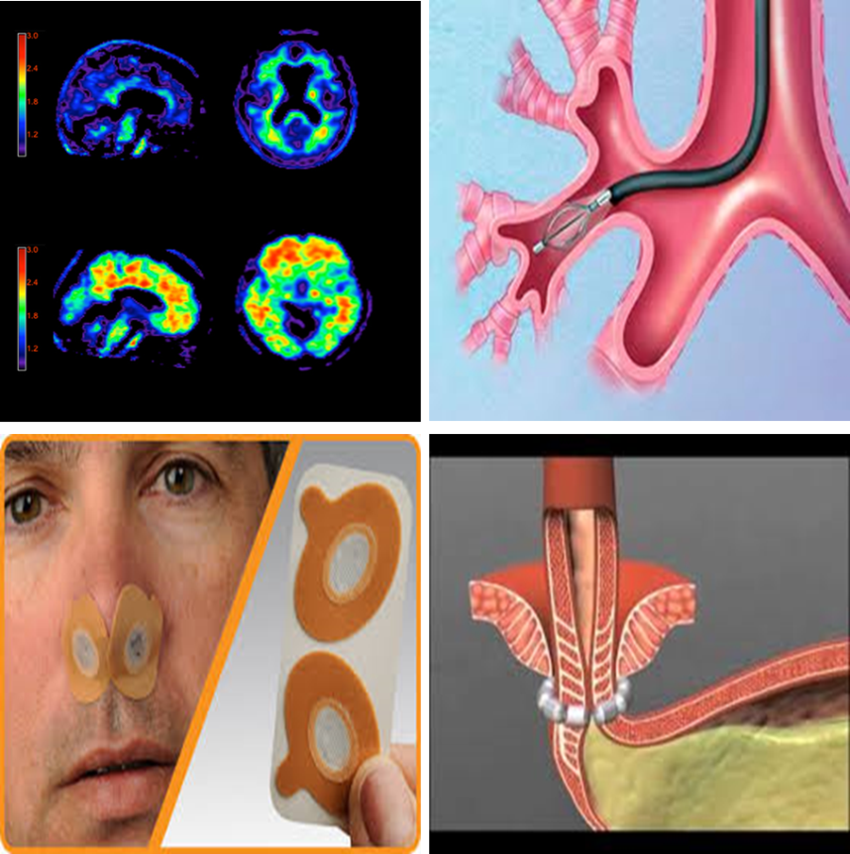
Product Development
There are a million highly engineered technologies that are not being reimbursed.
  Amyvid PET imaging for Alzheimer's disease (Eli Lilly & Co.)
  Provent for obstructive sleep apnea (Theravent, Inc.)
  Bronchial thermoplasty for asthma (Boston Scientific)
  LINX for GERD (Torax Medical)
Think about reimbursement from day one.
No use developing a technology that no one will pay for.

Slide 12
FDA
FDA clearance is insufficient for insurance coverage of new products.
    EPA testing for fuel economy
>70% of FDA cleared technologies are not covered by insurance because they are neither safe nor efficacious.
If your product is 510k, you still need to do a trial. The FDA won’t make you but payers will.

Slide 13
Venture Capital
More VC dollars should be going to determine clinical utility
Less VC dollars should be going to building companies

Slide 14
Contact Information
Scott Marland
  smarland@utah.gov
S. George Simon
  biocorpdev@comcast.net
Nic Anderson
  nicholas.c.anderson@gmail.com

